Slide 1
Digital Portfolio
STUDENT NAME: SANTHOSHPANDI .P
REGISTER NO AND NMID: 2422K1471 & santhoshpandipnm2422k1471@gmail.com
NMID :3F4C5785C0D1398ABCC4C4E3CC79BAC3
DEPARTMENT: B.Sc (cs)
COLLEGE: COLLEGE/ UNIVERSITY:GOVERNMENT ARTS AND SCIENCE SATHYAMANGLAM,638401,ERODE/BHARATHIAR UNIVERSITY

Slide 2
PROJECT TITLE
DIGITAL PORTFOLIO

Slide 3


AGENDA
Problem Statement
Project Overview
End Users
Tools and Technologies
Portfolio design and Layout
Features and Functionality
Results and Screenshots
Conclusion
Github Link
3/21/2024 Annual Review

Slide 4

PROBLEM STATEMENT
Details from the File
The portfolio aims to present Priya’s work in HTML, CSS, JavaScript, and React.
It features sections for work samples, such as a task manager and an online store.
It includes channels for contact and professional networking (email, LinkedIn, GitHub).
Goals
Demonstrate technical skills with real project examples.
Provide a professional platform for career opportunities.
Make the content accessible through a responsive, well-designed layout.

Slide 5

PROJECT OVERVIEW
Purpose and Goals
The primary purpose is to present Priya’s technical abilities in HTML, CSS, JavaScript, and React.
The site serves as a digital resume and project showcase, targeting potential employers, collaborators, and clients.
Main Features
Work Portfolio: Displays Priya's key projects, such as a portfolio website, a task manager, and a mock online store.
Contact Information: Provides a direct email and links to Priya’s LinkedIn and GitHub, making it easy to connect professionally.
Responsive Design: Ensures usability and visual appeal across all devices by leveraging modern frontend technologies.
Target Audience
Employers, recruiters, fellow developers, and anyone interested in Priya’s development work or seeking collaboration opportunities

Slide 6

WHO ARE THE END USERS?
Primary End Users
Recruiters and Employers: People seeking to evaluate Priya's skills and portfolio for job opportunities in web development.
Collaborators and Peers: Other developers or designers who may be interested in collaborating on projects or networking professionally.
Clients: Individuals or businesses looking to hire Priya for freelance web development or design work.
Secondary End Users
Educators or Mentors: Those evaluating Priya’s progress as a web developer or reviewing her work for academic or training purposes.
General Audience: Anyone interested in learning about Priya’s work, project ideas, or design concepts.

Slide 7

TOOLS AND TECHNIQUES
Core Tools
HTML: Used for structure and layout of web pages.
CSS: Applied for designing styles, layouts, and ensuring responsiveness.
JavaScript: Adds interactivity and dynamic functionality to web components.
React: Utilized for building interactive user interfaces and managing website components efficiently.
Techniques
Responsive Design: Ensures the website works seamlessly across various devices and screen sizes using CSS and React principles.
Project Showcasing: Organized display of real-world projects with clear “View Project” prompts to navigate viewers through Priya’s work.
Clean, User-Friendly Layout: Prioritizes ease of navigation and visual appeal, showcasing technical skills through practical and attractive design.
These tools and techniques together highlight Priya’s strengths as a modern web developer and demonstrate her readiness for professional opportunities.

Slide 8
POTFOLIO DESIGN AND LAYOUT
Design Approach
Minimal and Professional: The site uses a straightforward layout focused on clarity, avoiding clutter and placing emphasis on her skills and projects.
Responsive User Interface: The design adapts seamlessly to desktops, tablets, and smartphones, ensuring accessibility and consistent experience for all users.
Layout Structure
Introduction Section: Features a brief personal introduction, highlighting Priya’s qualifications and web development skills.
Projects Showcase: Projects are presented with short descriptions and “View Project” buttons, helping users quickly understand Priya’s work.
Contact and Social Links: Clearly displayed email address, LinkedIn profile, and GitHub link provide easy access for networking or professional inquiries
8

Slide 9
FEATURES AND FUNCTIONALITY
Key Features
Personal Introduction: A concise section introducing Priya and highlighting her expertise in HTML, CSS, JavaScript, and React.
Project Showcase: Displays multiple real-world projects like a personal portfolio site, a simple task manager, and a mock online store, each with a brief description and a "View Project" link for more details.
Contact Information: Provides direct access to Priya’s email, LinkedIn, and GitHub profiles, facilitating communication and professional networking.
Functional Elements
Responsive Design: The website adjusts smoothly across different devices and screen sizes, ensuring easy navigation and readability.
Interactive Links: “View Project” buttons lead users to detailed views or live demonstrations of Priya’s projects, enhancing engagement with the content.
Clean Navigation: The layout supports straightforward browsing without overwhelming visitors, emphasizing clarity and accessibility.

Slide 10
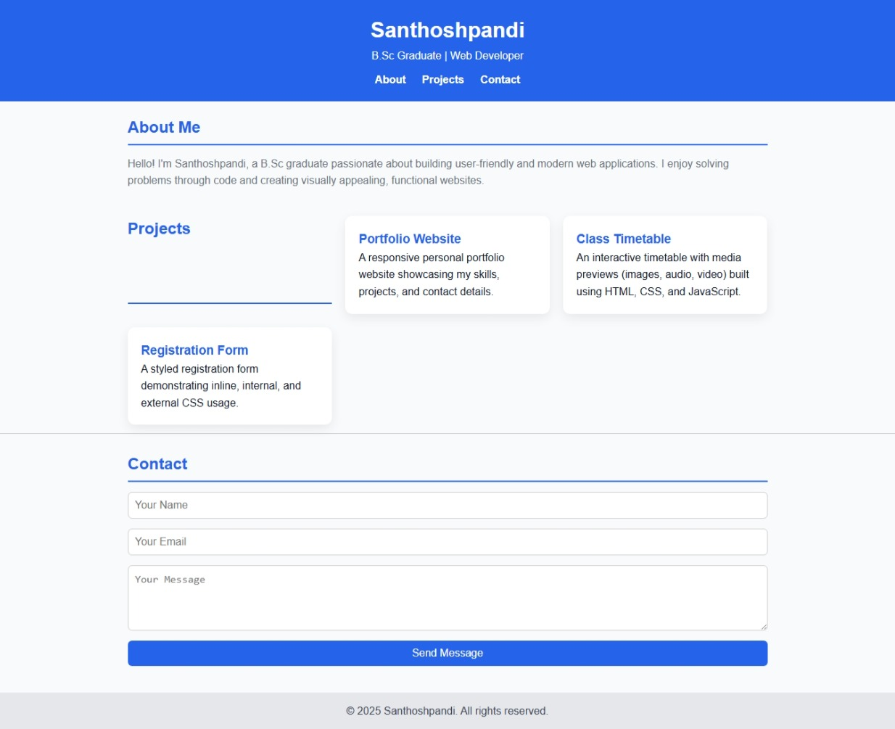

RESULTS AND SCREENSHOTS
3/21/2024 Annual Review
10

Slide 11
CONCLUSION
santhoshpandi personal portfolio website is a well-crafted digital platform that effectively showcases her skills in HTML, CSS, JavaScript, and React through real-world projects. The clean, responsive design and intuitive layout make it easy for recruiters, collaborators, and clients to explore her work and connect with her professionally.
This portfolio not only highlights technical expertise but also serves as a professional bridge to career opportunities by providing clear access to her contact information and social profiles. Overall, the project demonstrates commitment to quality web development and positions her strongly in the competitive tech landscape
11

